Slide 1


Welcome to the
Clearwater High School
Tornado Band

Slide 2
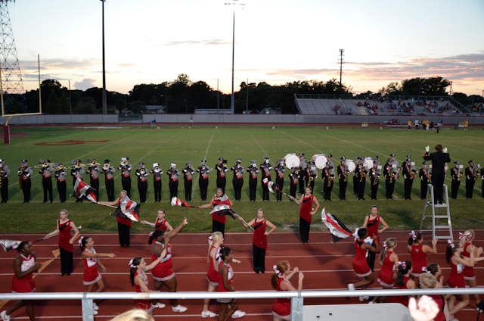
CHS Tornado Band
You are joining a TRADITION over 100 years in the making.

Slide 3
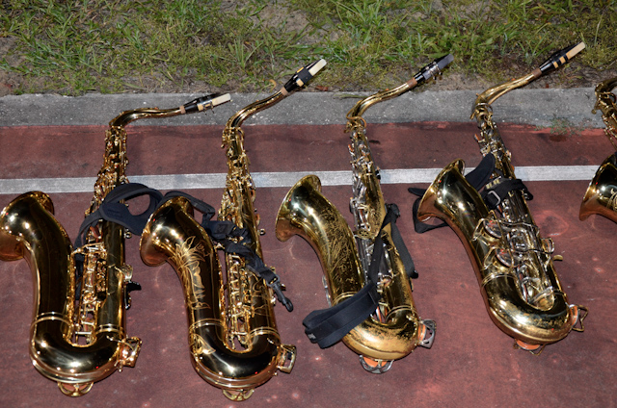
Band Booster Board of Directors
President – Brett Wilson
Executive Secretary/Media Coordinator – Melissa Creaser
Controller – Steve Edewaard
Treasurer – Dawn Hernandez
Volunteer Coordinator – Trina Tyler
External Fundraising Coordinator – Melissa Richards
Internal Fundraising Coordinator – Jim Richards
Ensemble Coordinator – Mandy Wilson

Slide 4
Band Fees
Fees are required to keep our band program functioning. The Pinellas County School Board does NOT provide funds for the costs incurred in running our band program. Each year the Band Director along with your Board of Directors determines the funds needed to sustain the program based on previous years expenses, expected expenses for this year, and the number of students we expect to have participating.
The Clearwater High School Band Boosters is a non-profit organization therefore, our budget is for a zero profit or loss. Band fees are kept as low as possible to ensure maximum participation. We are proud to have one of the lowest “fair share” costs in Pinellas County. No student will be excluded for financial reasons however, it is your responsibility as a parent, along with your student, to participate in the many fund raising activities that are available to pay these fees. The fundraisers we offer to our students and parents can completely off-set the band fees if optimized.

Slide 5
Fair Share Accounts
As a member of the Clearwater High School Band, the booster organization establishes an account for each student and it is referred to as his or her “Fair Share Account”.
The Treasurer will maintain this account on your behalf to keep credits earned from fundraisers and dues payments made to off-set band fees.
A monthly statement will be sent to you showing all credits earned, payments, and remaining band fees.
Accessory Fees and band related expenses, such as band practice shirts, shoes and gloves, can be charged to your Fair Share Account as long as you have a credit balance, otherwise these items will need to be paid for at time of purchase.
All individual accounts will be kept confidential.

Slide 6
2016-2017 Fair Share Fees
          Marching Band $500.00
          WINDS
          PERCUSSION
          COLOR GUARD
          Concert Band $50.00
          WINDS
          PERCUSSION ENSEMBLE
          Winter Guard $500.00
Booster Operational Fees are used for all aspects of the program throughout the school year. Examples of what these fees pay for include:
Instructors and Staff for Marching and Concert Seasons Competition and FBA Entry Fees
Transportation Expenses Marching Show Music and Drill
Marching Props and Guard Equipment Office Supplies & Postage
Concession Stand Maintenance and Repair Expenses Guest Clinicians and Consultants
First Aid Supplies Awards and Banquet
Band Camp Food and Picnic Senior Night Flowers
Booster Fees: Make checks payable to Clearwater High School Band Boosters (C.H.S.B.B.)

Slide 7
Pinellas County Fees
Instrument Rental $60 per year or
$35.00 per semester
Uniform Rental $50 per year
Pinellas County School Fees need to be paid for during summer camps or at summer parent meetings.
All Wind and Percussion students are required to pay for uniform rentals.
Any student who uses a school instrument(s) is required to pay for an instrument rental. This includes all percussion players.
Payments of cashier’s check, money order or personal check will be accepted.
Pinellas County Fees: Make check payable to Clearwater High School
Notes:
Need to make a note in packet that this is incorrect we do not accept cash anymore please correct

Slide 8
Uniform/Accessory Expenses
Marching Shoes $39.25/pair
Marching Gloves $3.80/pair - 3 pairs needed
Practice T-Shirt $10.00 each
Pep Band Shirt $12.00 each
Marching Color Guard Uniform* Ladies – TBD
Color Guard Shoes TBD
Color Guard Equipment Rental - $30 (covers Fall and Winter Guard)
*The Guard Uniform may include a unitard and in some instances, compression garments
Booster Accessory Fees will need to be paid for during summer camps or at summer parent meetings.
Accessory Fees: Make checks payable to Clearwater High School Band Boosters (C.H.S.B.B.)

Slide 9
Payments to CHSBB
Payments of personal check, cashier’s check or Money Order will be accepted.
Make checks payable to Clearwater High School Band Boosters (C.H.S.B.B.)
Payment by Credit Card using our “Square” account can be made for some items (shirts/shoes/gloves), but a 2.85% fee will be added to the price of each item.
Please, no Cash payments.

Slide 10
UNIFORM FITTINGS
WINDS & PERCUSSION:
Students will be fit for marching shoes and gloves during band camp.
Day and Time - TBA
ALL new students will need to purchase 1 pair of shoes, as well as those veterans who need replacements. ALL WINDS will need to purchase three pairs of black marching gloves for the season.
COLOR GUARD:
Fitting for CUSTOM FIT uniform will be at TBD Dates at Guard practice.
ALL Payments must be made before we can place the order for the uniforms. All Guard uniforms will take a minimum of 8 weeks to be fulfilled.
Make checks payable to Clearwater High School Band Boosters (C.H.S.B.B.)

Slide 11
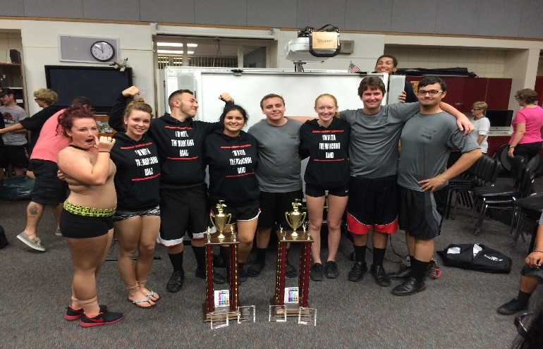
Practice Uniform
Practice uniforms are required to be worn for each practice and rehearsal, as well as under your marching uniform for ALL football games & performances.
Practice Uniform consists of:
    Ash gray T-shirt
    (screen printed with CHS Band logo)
    Black Shorts
    Sneakers
Practice t-shirts are sold by the Band Boosters at parent meetings and via order form and payment through the black box.
Veteran students who have shirts in good condition do not need to purchase new ones.

Slide 12
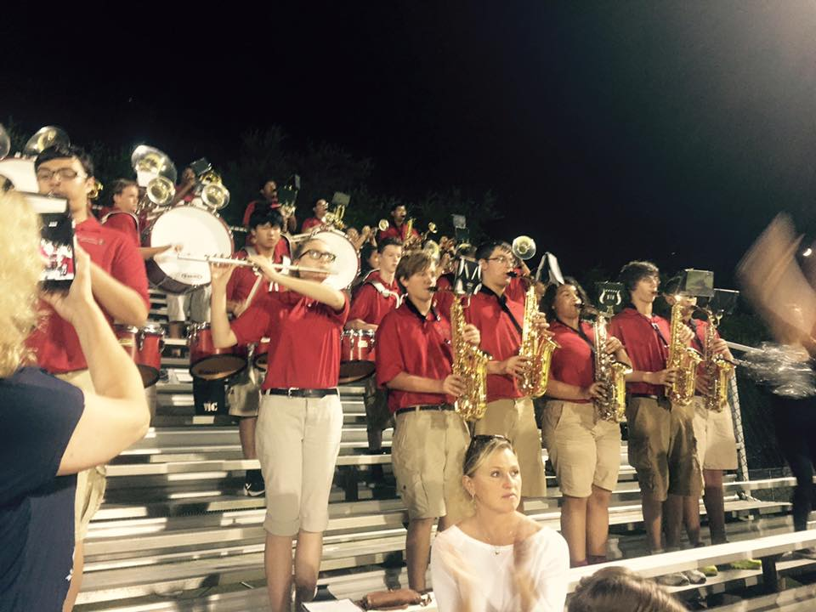
Pep Band Uniform
Pep Band uniforms are used in place of the official Marching or Concert Uniforms for certain events.
Pep Band Uniform consists of:
    Red Polo Shirt
    (screen printed with the CHS Band logo)
    Dark Khaki Shorts
    Sneakers
Pep Band polo shirts are sold by the Band Boosters at parent meetings and via order form and payment through the black box.
Veteran students who have shirts in good condition do not need to purchase a new one.

Slide 13
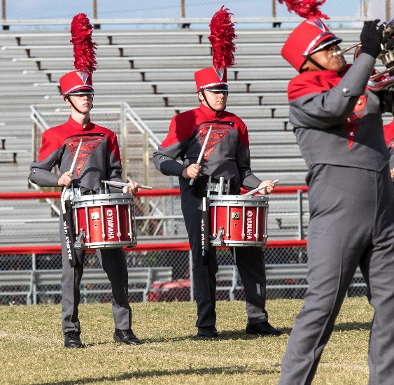
Marching Band Uniform
Pinellas County Schools provide Marching Uniforms for wind and percussion members. Students are fully responsible for uniform parts issued to him or her. Replacement cost of a lost or damaged uniform could cost as much as $350 so be sure to treat these garments with the upmost respect.
Marching Uniform consists of:
    Band issued jacket, bibs, shako and accessory parts
    Black Marching Shoes
    Black Gloves
    Extra Long Black Socks
    Band Practice T-Shirt and Shorts
Students will be professionally fitted for uniforms.
The Pinellas County Schools once a year fee must be paid in full on or before the day of your uniform fitting.

Slide 14
Fundraising
The Band Boosters offer numerous fundraisers throughout the year in order to assist families in managing their student fair share account.
Operational Fundraising - puts proceeds toward the general operational fund, which in turn benefits all students in the band program. However, several of these programs put monies into an individual student’s Fair Share Account as well.
  Examples of these types of fundraiser include:
  Phillies Parking Football Concession Stand
  City Gates Tag Days
  Spirit Nights Car Washes
  Chick-fil-A Calendars Rummage Sales
  Corporate Sponsorships Tornado Tournament Sales

Slide 15
Fundraising
Individual Account Fundraising - is designed to put money directly into an individual student’s Fair Share Account.
  Examples of this type of fundraiser include:
  Catalog Sales Tournament Program Ad Sales
  Chick-fil-A Calendars Sunglass sales
  Car Wash Ticket Sales

Slide 16
Communication
Website:
Our primary communication tool is the CHS Band website. This site is updated almost daily. Please visit often so you have the latest information. Be sure to add this website to your favorites.
    www.clearwatertornadoband.com
    Members Only Section:
    Password: Grind2017
Weekly Newsletter:
Our secondary communication tool is the Weekly Newsletter. The newsletter is sent every Sunday evening and goes to the e-mail address you and your student have on file. The newsletter may contain a note from Mr Sopko, the rehearsal and practice schedule for the week, fundraising opportunities and up-coming events. It is critical for you to read these e-mails to be informed about current events.

Slide 17
Communication
Band Parent Meetings:
Another method of communication is our Monthly Band Parent Meetings. Our Parent Meetings are every third Tuesday of the month at 7:00 p.m. in the Band Room.
We will discuss up-coming events, fundraisers, trips and answer ANY questions you may have about the band program. It also affords you the opportunity to hear from and speak to, Mr Sopko. This is a great time to meet other Band Boosters and get involved in your Clearwater High School Band program.
Students are welcome to join the meeting.

Slide 18


Slide 19




Band Camp
Band Camp is required for CHS Marching Band Students. During Band Camp, students work full-time on the musical compositions and drill for the 2016 Football and Marching Competition season.
Lunch – Student must bring
Friday – Students must bring swim suit and towel…
Band Camp: Mandatory for all Band Members (Winds, Percussion, and Guard)

Slide 20
Band Camp – Daily Schedule
Mon – Thurs 7:45am – 6:00pm
Friday schedule need suit and towel
Time
7:45 am | Students are expected to arrive with water, towels and sunscreen wearing socks and sneakers
8:00 am | Announcements by Mr. Sopko (MS) to include: daily schedule, goals and CHSMB Calendar
8:15 am | Basics marching and positioning: Horns, color guard with a flag: outside to stretch and begin field show drill. Battery to the choir room to warm up, Pit to stay in the band room.
9:30 am | Break: snacks and water provided by the CHS Band Boosters
9:45 am | Battery outside to join the Horns and the Guard for field drill
10:30 am | Break: and water provided by the CHS Band Boosters
12:00 pm | Lunch Break
12:45 pm | All outside to march what was learned this morning
1:30 pm | Inside, Guard to the ensemble room to review work and choreography Horns and pit in the band room, Battery to the choir room
3:00 pm | Break: snacks and water provided by the CHS Band Boosters
3:15 pm | Team building exercises in the choir room or auditorium
3:45 pm | All will learn the music and choreography of the show Horns in the choir room, guard to the ensemble room, battery and pit to the band room
4:30 pm | Break: snacks and water provided by the CHS Band Boosters
4:45 pm | Outside to march, perform what was learned.
5:50 pm | Announcements, Clean up
6:00 pm | Dismissal

Slide 21

Band Camp Survival Kit
Items you Need to Bring:
Your Instrument with Reeds and Mouthpieces
Light colored T-Shirts, Tank Tops or Sleeveless Shirts
Shorts: Comfortable – NO Jeans and NO Long Pants
Socks and Comfortable Sneaker Style Shoes –
NO Sandals and NO Flip Flops
Sunglasses and/or Hat
Sunscreen: Sweat proof is the best
Chap-stick

Slide 22

Band Camp Survival Kit
Water and/or Gatorade: It is VERY important to stay hydrated!!
  Please mark your name on it and bring LOTS of it.
Pencils: Sharpened with erasers
Highlighters
3-Ring Binder: To create your Drill Book
Page Protectors
Extra Long Shoelace: For your Drill Book
Good Attitude

Slide 23

How Can You help?
Water, water, water- gallons
Cups (8oz Sizes)
Powdered Gatorade- big 5-6 gallon size
Paper Towels
Safety pins, bandages of ALL sizes, small hair bands
Ice packs- the kind you break to get cold
Feminine hygiene products of all kinds
Individual nail polish remover wipes
Windex disposable wipes
Good Fabric Scissors to cut glove tips
Individually packed crackers, cookies, pop-tarts, etc
Tents, coolers

Slide 24

We Need you . . .
Parent participation and involvement is a vital aspect of the continued growth of our program. We have numerous activities, committees and opportunities for you to volunteer for, to become a part of the Clearwater High School Band program.
Volunteer Registration
This Pinellas County School Board form must be completed by ALL new and returning parents who will be involved in any band or school volunteer activities throughout the 2016 - 2017 school year.
In addition to the form, you must provide a copy of a valid driver’s license and/or other official photo identification.
All volunteers must be cleared by Pinellas County Schools prior to any volunteer activity.
This form and photo ID must be turned in prior to band camp.

Slide 25
Band Picnic
Our first Band Family get-together will be a:
Band Picnic
Saturday – July 30, 2016
11:00 a.m. – 2:00 p.m.
at Highland Rec Center Pavilion
(The pavilion is northeast of the Pool area, next to the Playground)
Band Boosters will provide burgers, hotdogs, and water and the band family (each section will be assigned for different things) will provide sides and desserts to share.
Bring your own drinks and chairs.
chips - trombone, drum/percussion
Salads - clarinet, sax, trumpet
fruits/veggies - guard
dessert - flute, drum major, tuba, mellaphones

Slide 26

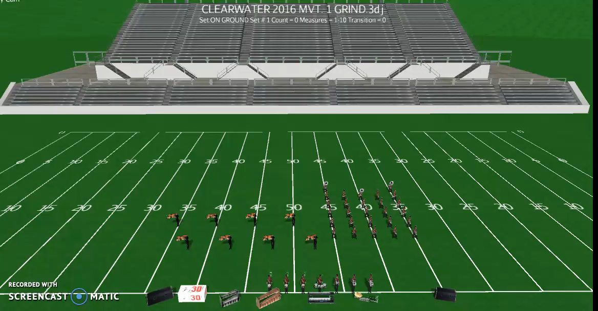
The Grind

Slide 27
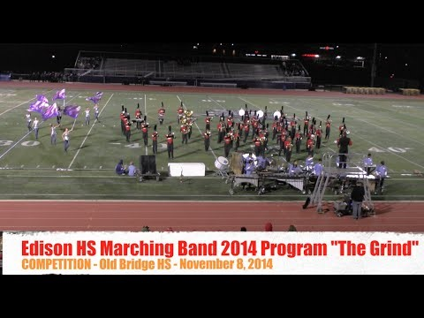
The Grind

Slide 28
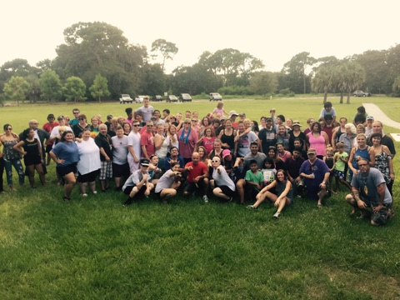
S-U-D-A!

